Slide 1
Comparing Effectiveness of 2 Antibiotics for Stenotrophomonas infections
Aug 2, 2018
NIH / National Institute of Allergy and Infectious Diseases
Elaine Lai

Slide 2
Problem/ Project
Compare effectiveness of 2 antibiotics for the Stenotrophomonas maltophilia infected cohort
S. maltophilia is a relatively harmless bug for an average person
Problematic for hospitalized patients, esp. immunocompromised, critically ill
Intrinsically resistant to many effective & common antibiotics
Current standard treatment , trimethoprim-sulfamethoxazole (TMP-SMX) is a strong drug and is quite toxic
Levofloxacin is a drug with in vitro activity against S. maltophilia, however, previous studies have been small and single-centered, and no randomized controlled trials have been conducted.

Slide 3
Data
Large Electronic Medical Records (EMR)
63 million unique patients, 21.5 million inpatient encounters
Relational database
Many tables linked by a few common “keys” like patient ID, hospital visit ID, etc.
2009 to 2017
Deidentified

Slide 4
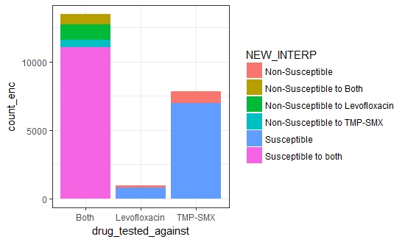
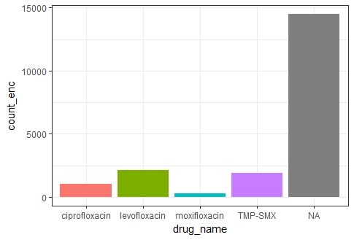
Data Process and Findings in Exploratory Data Analysis (EDA)
Discard
Treated with both drugs?
Laboratory Data (Culture) Find all cultures positive with S. maltophilia
Is it resistant to either/both 2 drugs of interest? (Drug susceptibility)
Yes
Did patient receive any S. maltophilia-active treatment?
(Medication)
True S. maltophilia infection
No
Yes
Yes.
Discard.
Can’t compare
No
No
Probably colonization. Discard
Study Population
(Demographics/Outcome)
(Diagnoses)
(Procedures)

Slide 5
How are EDA findings helpful?
Found majority of S. maltophilia infections to be susceptible to both drugs
Found only a portion of S. maltophilia positive patients have been treated with active drugs (i.e. many positive cultures are probably colonization)
Inform final size of study population in order to plan for appropriate analyses

Slide 6
New Questions/ Things To Try
Question
Are there any further exclusion criteria that I should set?
Are there enough people to match on propensity scores for each group?
Things to try
Side project: K-Nearest Neighbor (KNN) to bin culture into categories by their collection site
Propensity Scoring and Matching
Truly compare between similar groups
Principal Component Analysis (PCA)
Mastering the craft of modelling

Slide 7
Plans from now to Demo Day
Continue to establish exclusion criteria according to clinical knowledge and ensure cleanest cohort for analysis
Merge in additional necessary components
Meet with clinician researchers to ensure capturing correct characteristics and producing a model that makes clinical sense

